Slide 1
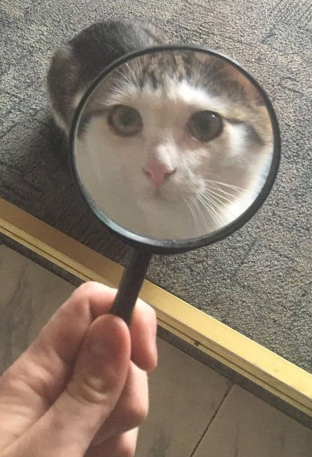
All About OSINT
Qr code
By:
Molly Jessica

Slide 2
[] Pals
Groups are assigned to a mentor
We do our best to pair pals with good mentors that are experienced in what they want to learn about!
Get to know other Pals!
We pair multiple pals to two mentors, allowing you to collaborate with others who have similar skill levels, so you can learn and grow together
Learn more about [] topics
Labs will expand upon weekly meeting topics!
Sign-ups end 09/14 at 11:59 PM
Notes:
Elias & Mat

Slide 3
Alumni Mentorship
1-on-1 mentoring
Paired with one [] alum
Network and learn from alumni
Build relationships with current and past generations of []
Gain better understanding of corporate world
Learn about alumni’s experiences
Internship/job preparation
Resume reviews
LinkedIn reviews
Mock interviews
Potential referrals for internships/job applications
Sign-ups end 09/12 at 11:59 PM!!!
*Contact [] with any questions
Notes:
Medha

Slide 4
#whoami
Molly

Slide 5
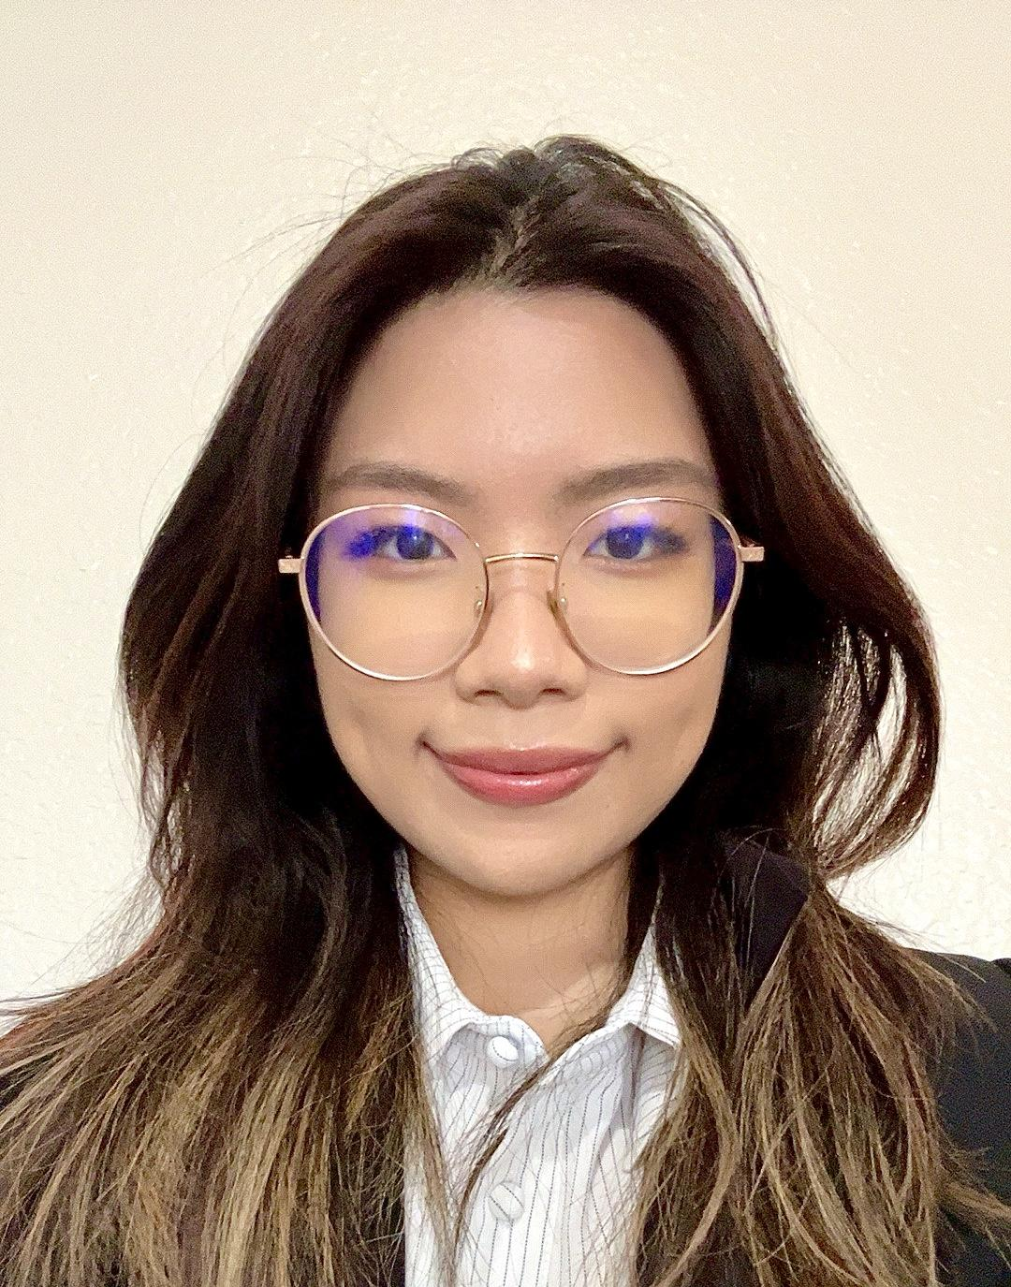

#whoami
Jessica / Arsenic
Computer Informations Systems
Director of Marketing

Slide 6
Table of Contents
01
What is OSINT?
02
Getting Started
03
OSINT Tool Demo
04
Resources

Slide 7
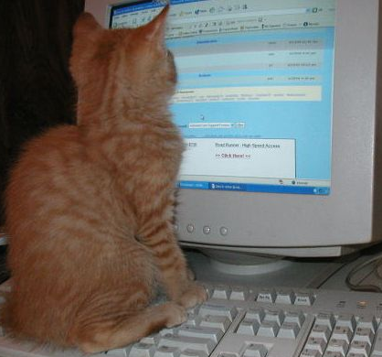
01
What is OSINT?

Slide 8


What is OSINT?
Open Source Intelligence
Have you ever:
Stalked someone on LinkedIn?
Look at ratemyprofessor for good teachers?
Play Geoguessr?
You have done OSINT :D
Finding publicly available information

Slide 9
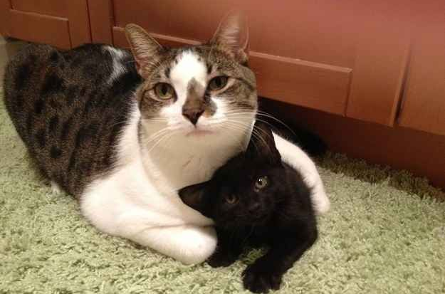
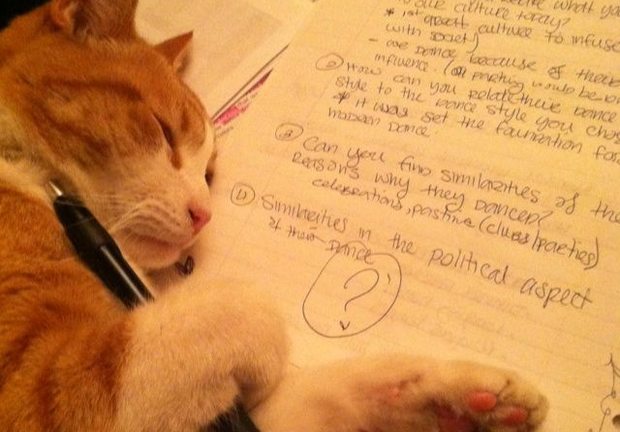
Why Should You Learn OSINT?
Understand the Attacker
Learn how public data can be found to protect your own
Threat Intelligence/Reconnaissance
Gather information on your target and their network

Slide 10


OSINT Pathways
National Security
Journalism
Research
Law enforcement
Criminal Justice
Intelligence Analyst

Slide 11
02
Getting Started

Slide 12
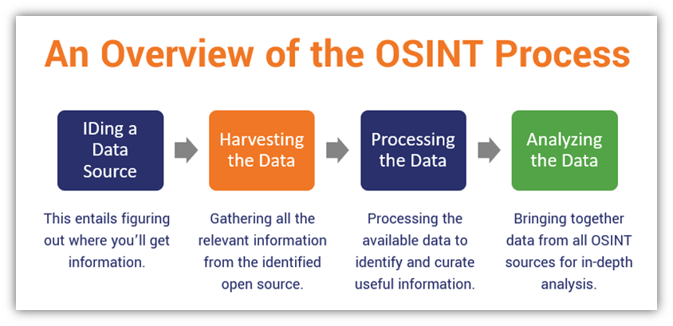
OSINT Process

Slide 13
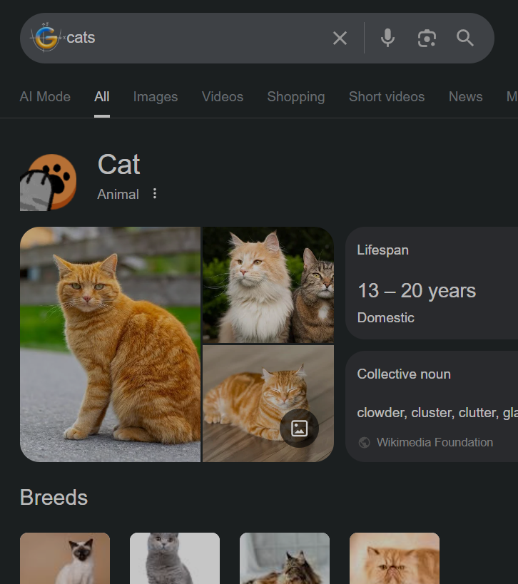
Google Dorking
- Using search operators to manipulate Google searches
- Can find old versions of pages, open directories, forgotten public files, etc

Slide 14
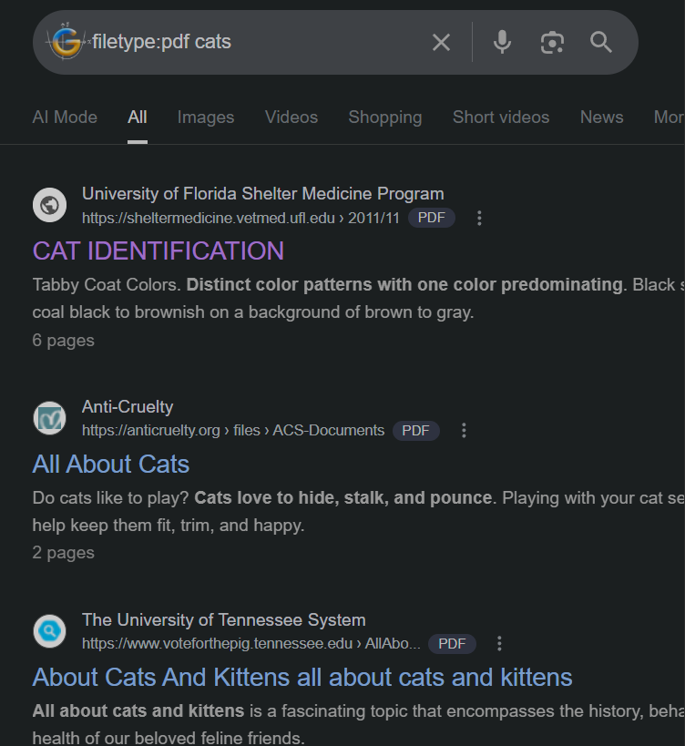
Google Dorking: Search PDFs

Slide 15
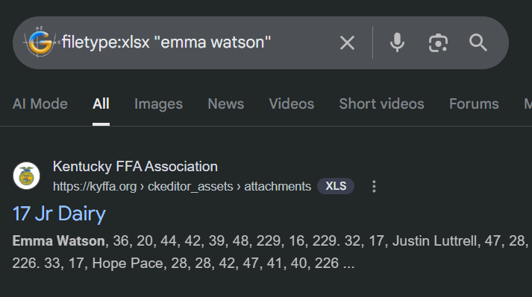
Google Dorking: Search Excel Sheets
Can search all public Excel Sheets
Manipulates Google Ranking algorithm
Domains with higher reputation like .edu and .gov may rank higher

Slide 16
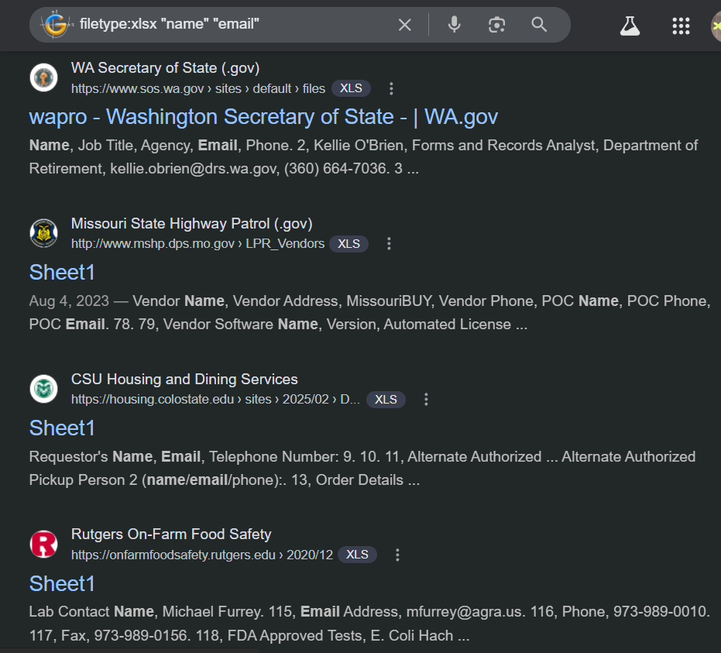
Google Dorking: Search Excel Sheets
Can search all public Excel Sheets
Manipulates Google Ranking algorithm
Domains with higher reputation like .edu and .gov may rank higher

Slide 17
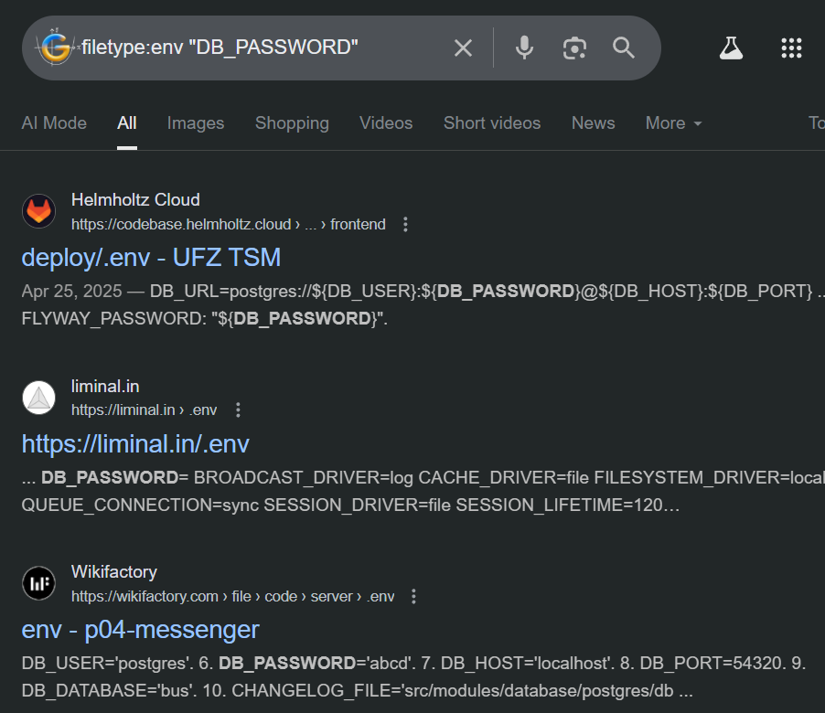
Google Dorking: Search Env Config Files
Env files should NEVER be public 💀
Environment Configuration Files may contain API keys, database usernames and passwords, etc

Slide 18
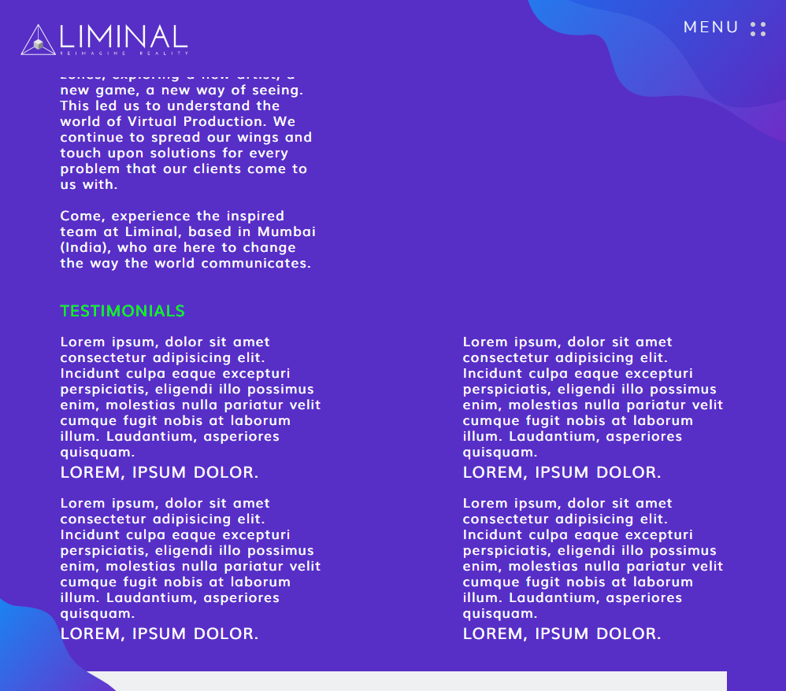
Google Dorking: Search Env Config Files
Attackers could:
Connect to the database and steal data
Access sensitive credentials
Trigger debug mode to show internal errors

Slide 19
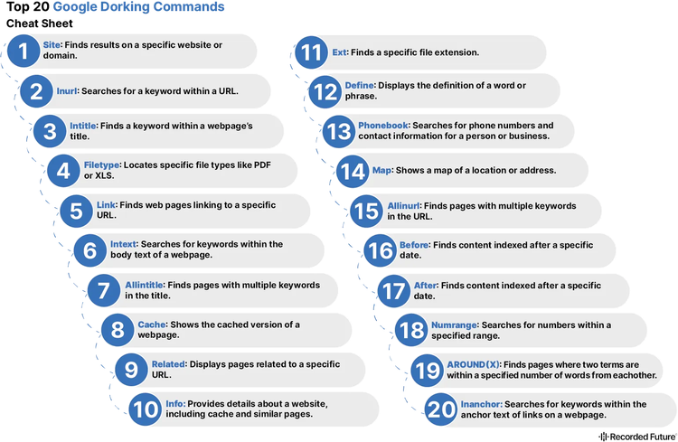

Google Dorking: Many Commands!

Slide 20
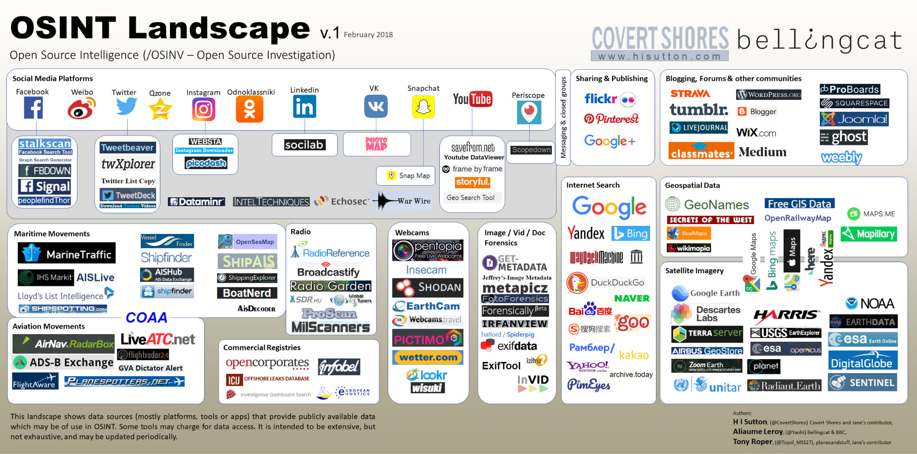
Why Are There So Many Tools?
Notes:
Sites that are advertised to serve the same purpose often have different capabilities Image forensics tools vary in what they extract, some focus on metadata, others on error level analysis, reverse image search, or pixel tampering
No single tool can detect all forms of image manipulation or trace every source, so combining tools increases accuracy and depth

Slide 21

Web Crawlers? Archiving? robots.txt?
Web Crawlers
Bot that looks at ALL data in World Wide Web
A lot of AI and search engines (if not all) use this for content farming
Archiving
An act where one keeps data in a specialized place
EX: Internet Archive
Robots.txt
A text file that tells web crawlers what content can be accessed
Malicious bots will ignore this

Slide 22
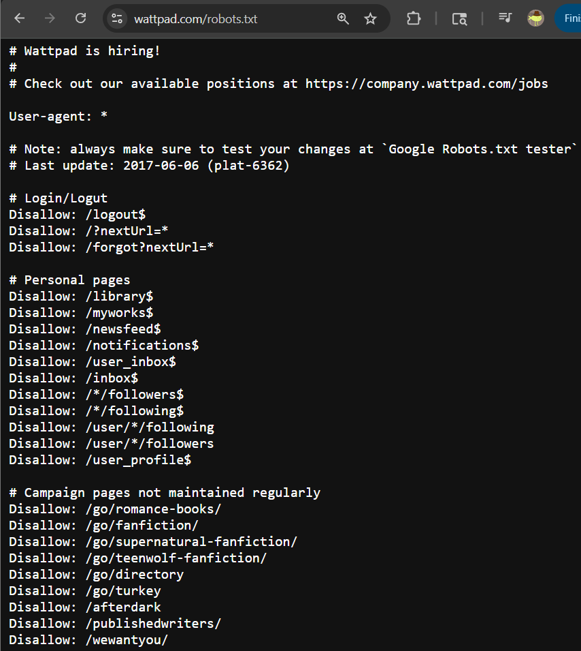
How Can We Use robots.txt for OSINT?
10 Minute Tip (Great Overview)
Robots.txt:
text file at the root of the website
Tells web crawlers which parts of the site they should not access
If there’s no robots.txt, crawlers assume full access is allowed
Notes:
Most major search engines (Google, Bing, Yandex) respect it Malicious bots often ignore it, especially scrapers and spam crawlers Ignoring robots.txt can lead to: Server overload, Exposure of sensitive endpoints, Violation of Terms of Service if a website has no robots.txt file, search engine crawlers can potentially access and index personal or private files that are publicly available.

Slide 23
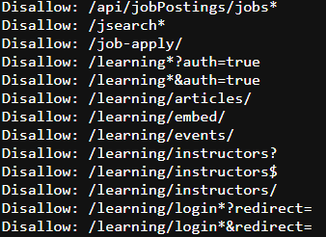
How Can We Use robots.txt for OSINT?
Ex: linkedin.com ->
You can’t use web crawler to access LinkedIn Learning content, Job Applications, Private Profiles, etc
Notes:
Some websites block specific crawlers (like Bingbot or Yandex) in robots.txt, so using multiple engines reveals content others might miss
Combine robots.txt findings with Google dorking for deeper access

Slide 24
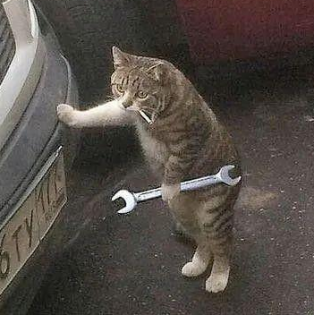
03
OSINT Tools

Slide 25

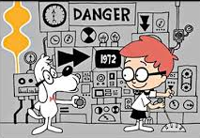
Search & Discovery: Wayback Machine
- Views historical snapshots of websites
- Malicious actors got away with blocking access to public records by putting them on robots.txt
- In 2017, Wayback Machine stopped honoring robots.txt to stop misuse
Notes:
Over time, the Archive noticed that robots.txt was being misused: squatters would acquire expired domains and add restrictive robots.txt files, erasing the site’s entire history from the Wayback Machine. Malicious actors could retroactively block access to public records without being the original site owner. Government and military sites changed hands between administrations, and robots.txt rules would suddenly hide critical historical content.

Slide 26
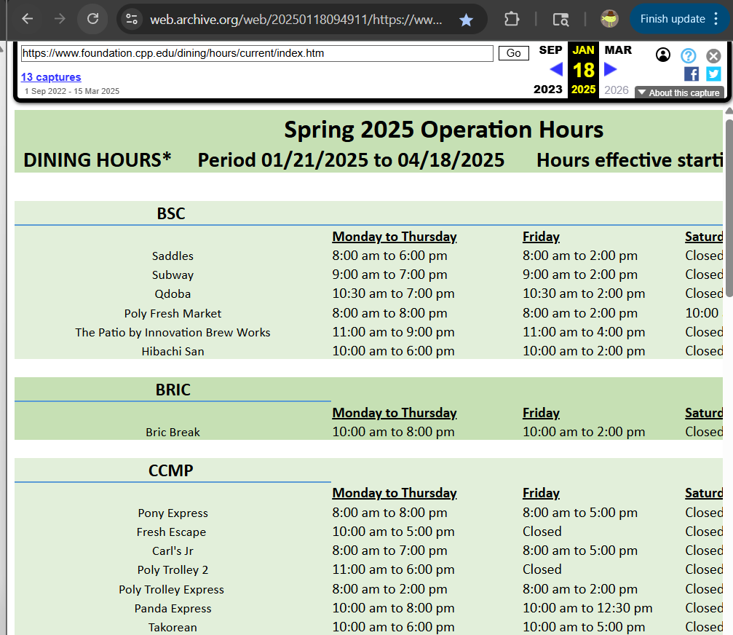
Search & Discovery: Wayback Machine
Before CPP updated their website, many sites had broken links
I used Wayback Machine to access the old Dining Hours page

Slide 27

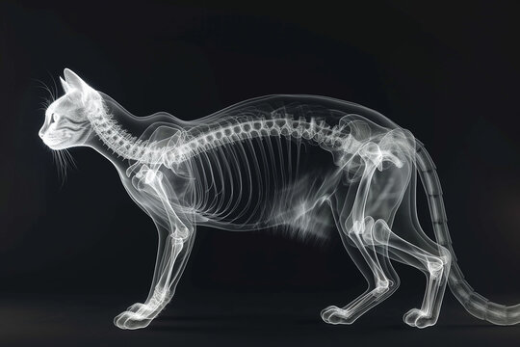
Search & Discovery: Shodan.io
Scans entire internet for devices and services that are publicly accessible
Ex. Open ports, device types, geolocation, banner info, ISP data, SSL certificates, CVEs
Notes:
CVE = Common Vulnerabilities and Exposures

Slide 28
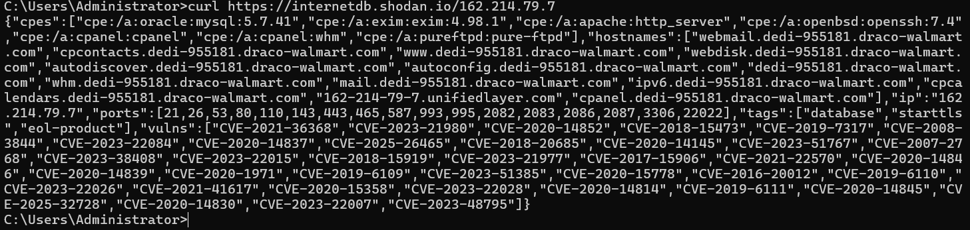
Search & Discovery: Shodan.io
^
All the CVEs that walmart.com is vulnerable to! Yikes!
CVE = Common Vulnerabilities and Exposures

Slide 29
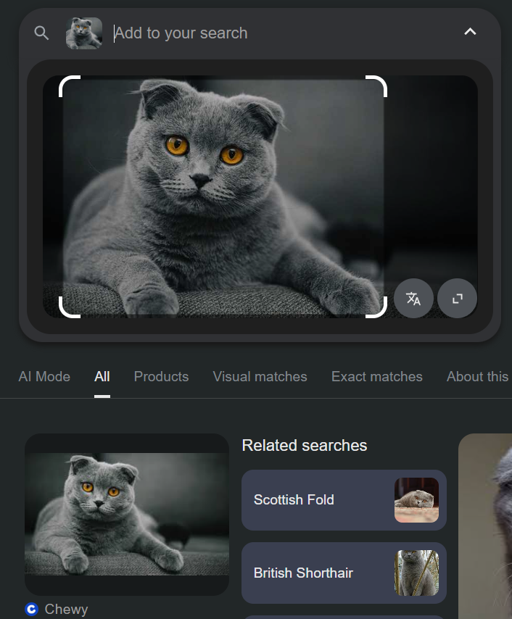
Reverse Image Search
Used to identify any images, faces, and locations
Spot catfish pictures, find the earliest upload of an image, find similar content, etc

Slide 30
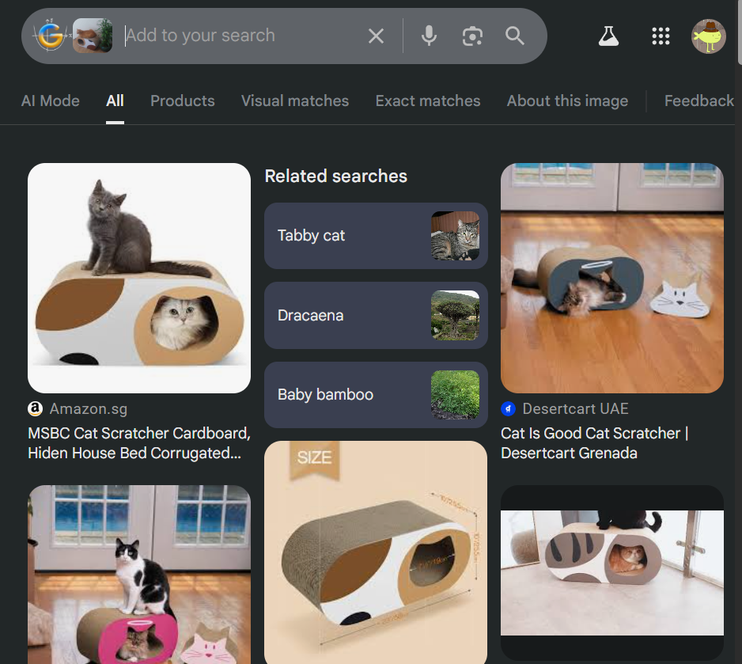
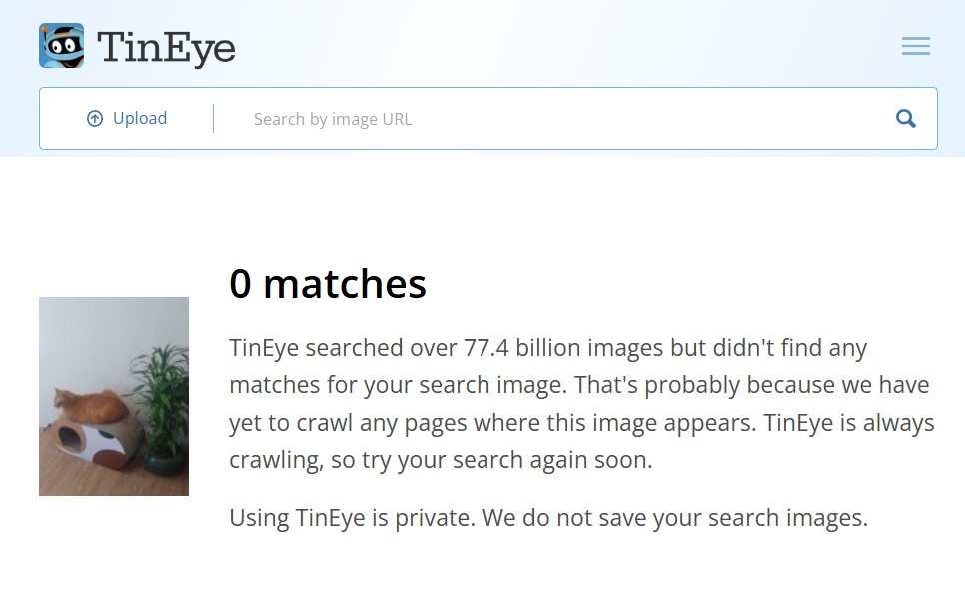
Reverse Image Search: AI vs Webcrawler
www.google.com/images
https://tineye.com/

Slide 31
Reverse Image Search
www.google.com/images: Uses Googlebot-Image crawler and Google Lens AI
https://yandex.com: Russia’s biggest search engine (comparable to Google and Meta in terms of inner workings)
https://tineye.com/: Crawls entire internet to find exact matches online
https://lenso.ai/en: Uses Content Based Image Retrieval AI tech for places, face recognition, and duplicates.
https://copyseeker.net/: Uses its own AI Image Search

Slide 32
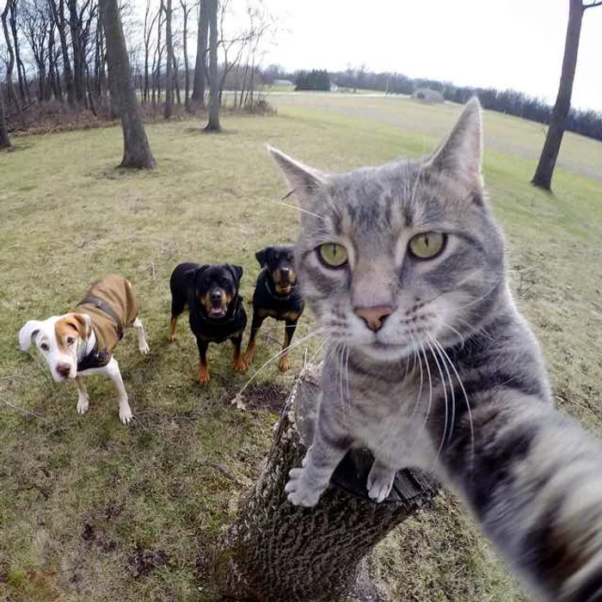
Social Media Intelligence
Namechk: Checks username availability across 100+ platforms
Who Posted What: Searches historical Twitter posts for verifying claims or finding deleted tweets
Notes:
Namechk was probably made to help people find available usernames to use but we use it for malicious purposes….

Slide 33
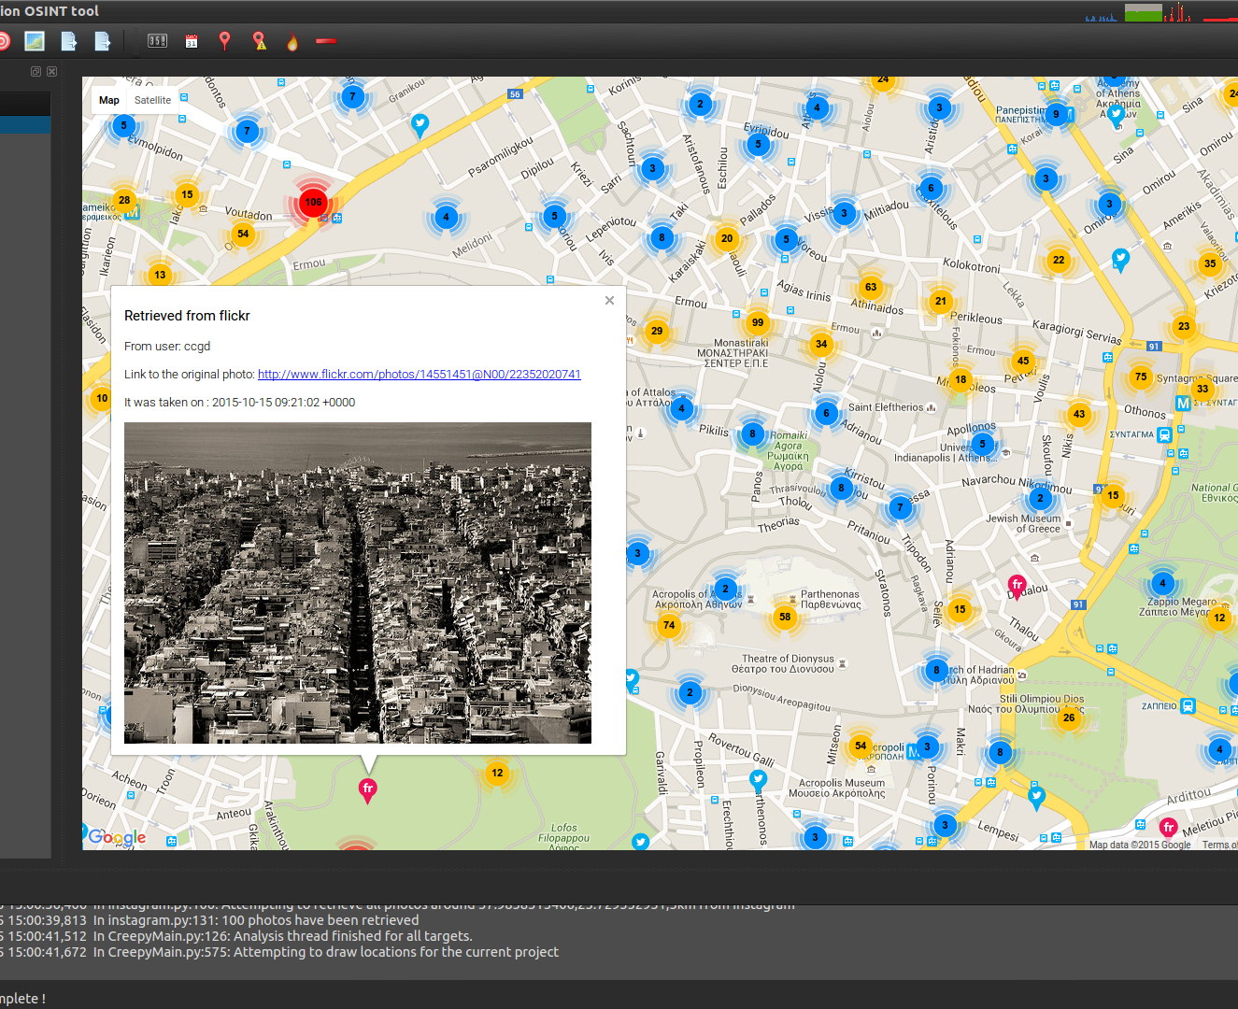
Social Media Intelligence: Creepy
Geolocation OSINT tool using social media metadata
Maps user activity based on posts with location tags
Creepy is indeed creepy

Slide 34

Social Media Intelligence: Sock Puppets
Fake online identity used by investigators
“Finsta”
In 2011, US Central Command’s Operation Earnest Voice made Twitter/Facebook sockpuppets to spread Pro American propaganda in Middle East

Slide 35
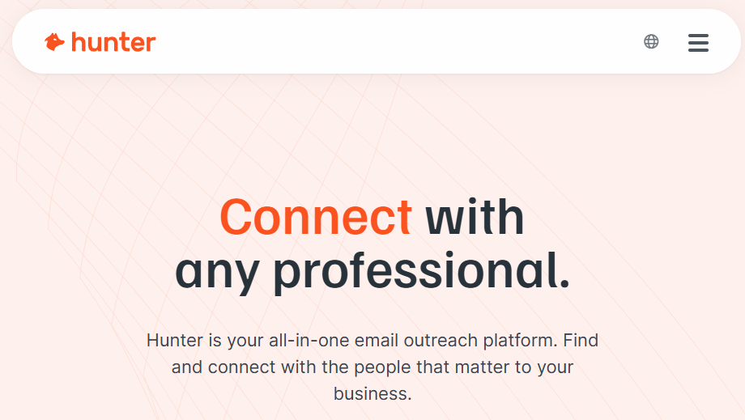
Domain & Network Intelligence
Discover publicly available data about domains, subdomains, emails, and infrastructure
hunter.io
Finds email addresses associated with a domain and verifies deliverability
(Checking someone didn’t give you a fake email 🥀)

Slide 36

Domain & Network Intelligence: TheHarvester
Pentest Recon Tool for gathering names, emails, IPs, subdomains, and URLs
LOTS of sources: Google, Bing, Yahoo, DuckDuckGo, DNSDumpster, Censys, Shodan, Netcraft, etc
Notes:
Many OSINT tools overlap on each other, like this one using Shodan

Slide 37
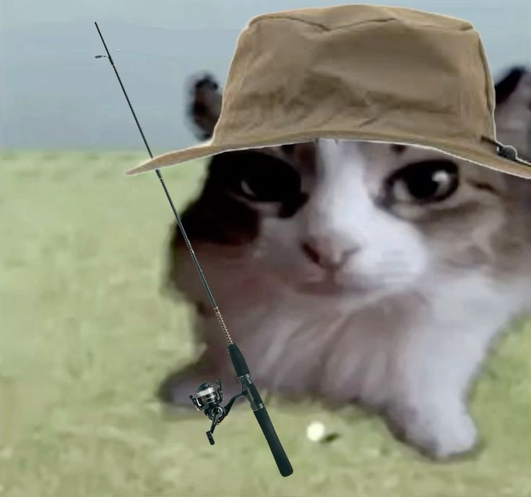
Image & Metadata Analysis
Metadata = “data about data”
Tools extract hidden data from images, documents, videos, etc
May include: timestamps, device info, GPS coords, IP addresses, edit history, user data

Slide 38
Metadata Analysis: Aperi Solve
https://stylesuxx.github.io/steganography/
Encode/Decode Steganographic Message for testing^
Aperi Solve is currently down but it included:
Zsteg, steghide, outguess, exiftool, binwalk
Many steganography, metadata, and forensics tools!

Slide 39

Metadata Analysis: Steg Challenge
File: https://drive.google.com/file/d/1RLB5LMyL6PadhGljwO6aLxf7vUH9fPTH/view?usp=sharing
Decoder: https://stylesuxx.github.io/steganography/
RIP Aperi Solve…

Slide 40
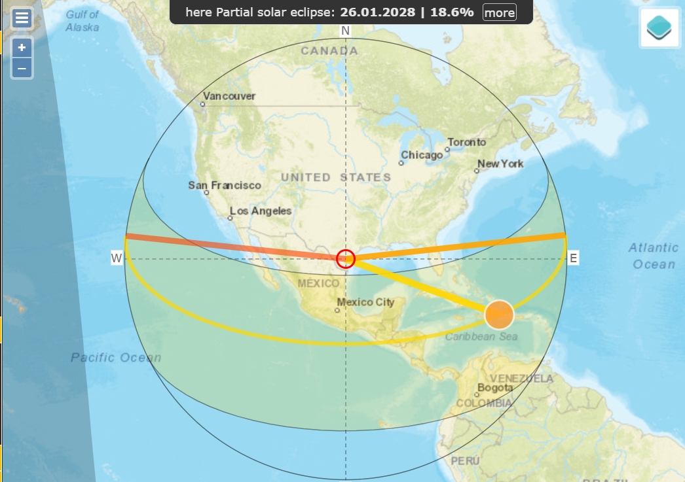

Geolocation & Mapping
Geospy
AI Location model
Mainly for enterprises/government
Mapillary
Free, open, and crowd sourced
Access ANY cameras in the world (street levels)
Bellingcat
“Researchers, investigators and citizen journalists brought together by a passion for open source research.” (“Who We Are”, Bellingcat)
Heavily focuses on transparency, open-source, and journalism
Suncalc
Data specifically for the Sun
Also contains geodata for selected locations on the map

Slide 41
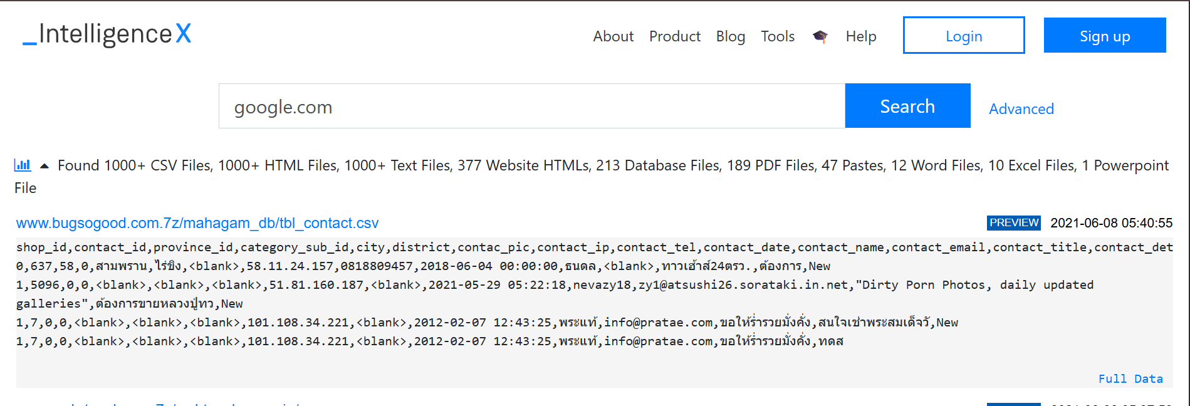
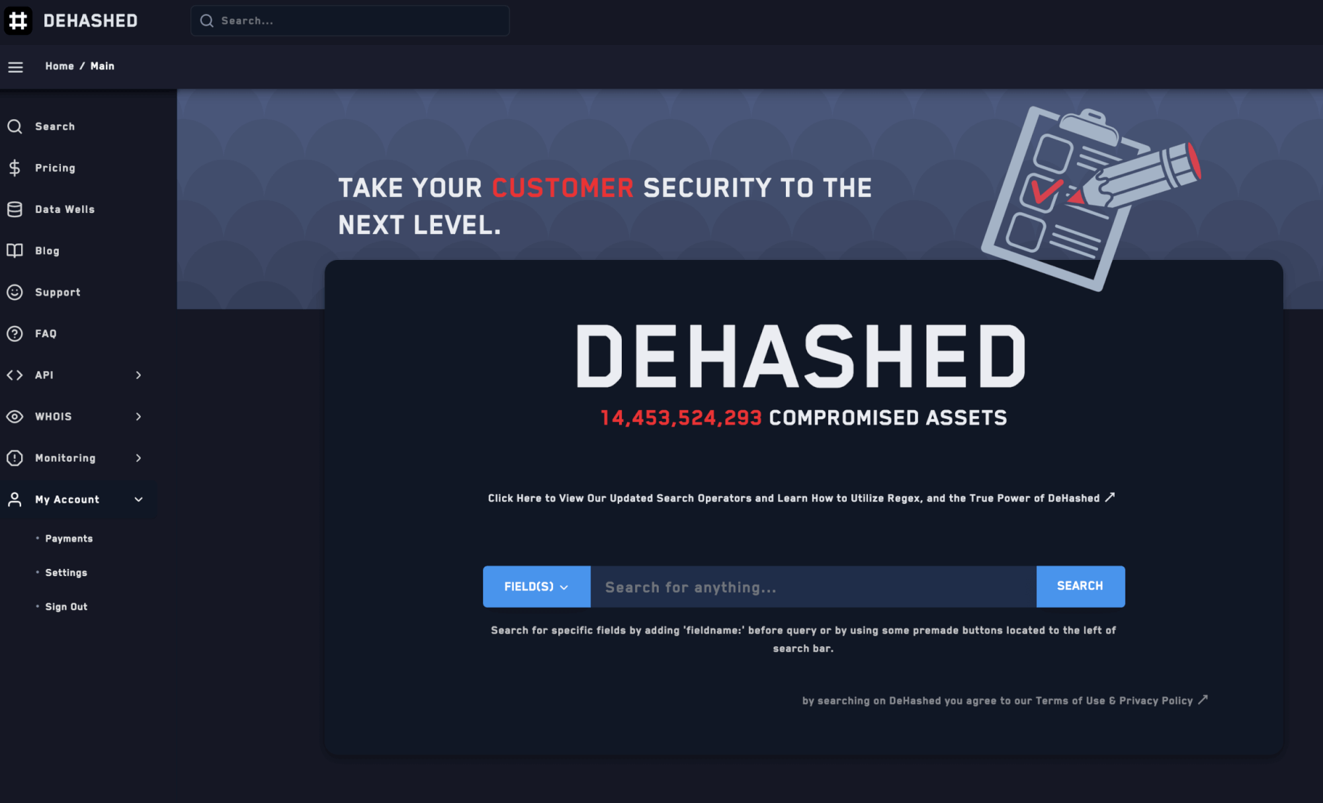
Data and Credential Leaks
Dehashed
Limited free access
Collects sensitive information in public and alert users on their data breaches
intelX
European based
Looks at EVERYTHING (IDs, Emails, WHOIS, Darknet, etc.)

Slide 42
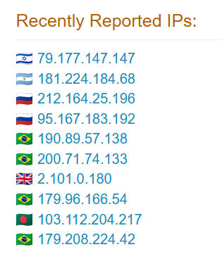
Threat Intelligence
Analyse URLs, domains, malware files, digital footprints, etc for malicious activity
AbuselPDB = Community driven threat reports of malicious IP addresses

Slide 43
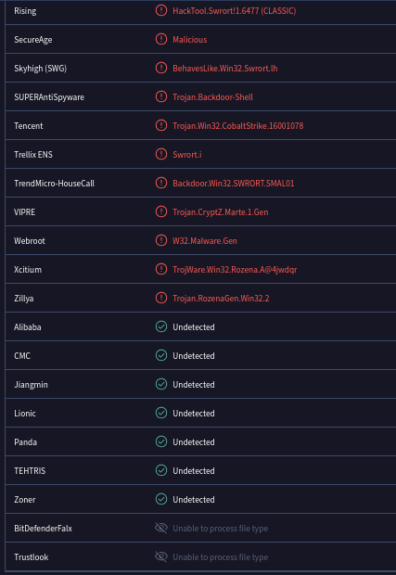
Threat Intelligence: Virus Total
Scans files, URLs, and domains for malware using 70+ antivirus engines
IOC Discovery
Indicators of Compromise can be malicious hashes, IP addresses, logs, etc that are added to a cloud-based threat intel ecosystem!
Notes:
Unless you’re on a private account, IOCs are added to a community database to continue advancing these tools

Slide 44

03
Resources

Slide 45
More Trainings
Try these beginner-friendly OSINT challenges to test your new skills :)
https://tryhackme.com/p/OSINT
https://tryhackme.com/p/OSINTDojo
https://gralhix.com/list-of-osint-exercises/
https://sourcing.games/

Slide 46
Competitions With OSINT
National Cyber League (NCL)
OSINT, Crypto, Password Cracking, Log Analysis, Network Traffic, Scanning, Enumeration and Exploitation, Forensics, Web Security (you will learn a LOT)
Challenge Gym with Walkthroughs + Individual/Team Game
Not free (SWIFT will get vouchers for Fall/Spring, stay tuned!)

Slide 47
Competitions With OSINT
PicoCTF
Free CTF hosted every year around March
Contains General Skills, Web Exploitation, Cryptography, Reverse Engineering, Forensics, Binary Exploitation
OSINT challenges may be under General Skills or Forensics
PicoCTF always has their PicoGym open for practice!

